Slide 1

ArcGIS Enterprise for Geospatial Big Data and Data Science using NERC
Haoyu Wang
Visiting Staff, Centre for Geographic Analysis, Harvard University
Devika Jain
Centre for Geographic Analysis, Harvard University

Slide 2
Agenda
Four chapters
Introduction (Exercise I)
Geospatial Big Data Fundamentals
Data Analysis and Visualization (Exercise II)
Case study (Exercise III & IV)

Slide 3
Chapter 1
Introduction

Slide 4

What is NERC?
New England Research Cloud (NERC)
Part of the Mass Open Cloud Alliance
Available to numerous institutions across New England
Provides cutting-edge cloud computing services for research
Built on OpenStack, a robust open-source cloud platform
Supports high-performance computing (HPC) workloads, enabling advanced research in fields like geospatial analysis, machine learning, and big data
Notes:
The New England Research Cloud, or NERC, is a cutting-edge resource that’s part of the Mass Open Cloud Alliance. It’s available to numerous institutions across New England, providing the computational power needed for modern research.
What makes NERC particularly powerful is that it’s built on OpenStack, a leading open-source cloud platform. OpenStack provides the underlying infrastructure that allows NERC to offer cloud computing services tailored to data-driven analysis, simulation, and visualization. This connection to OpenStack means that NERC benefits from a flexible and scalable cloud framework, which is ideal for research environments that require high-performance computing (HPC) capabilities.
Researchers can utilize NERC’s infrastructure for complex workloads in areas like geospatial analysis, machine learning, and big data. And because OpenStack is open-source, it allows for seamless integration with other cloud services, including hybrid setups that combine on-premise and cloud resources. This adaptability ensures that research institutions can tailor the platform to their unique needs while maintaining the security and control required for academic research.

Slide 5
What is ArcGIS Enterprise?
Foundational software system for GIS
Powers mapping, visualization, analytics, and data management
Tightly integrated with ArcGIS Pro for mapping and authoring
Enables collaboration and flexibility, accessible on any device, anywhere, anytime
Supports deployment on Microsoft Windows, Linux, and Kubernetes
Notes:
ArcGIS Enterprise is the core system that supports GIS operations. It powers critical GIS tasks like mapping, visualization, analytics, and data management. Think of it as the engine behind Esri's suite of applications, as well as any custom apps you might build.
One of its key strengths is its tight integration with ArcGIS Pro, making it easy to map, analyze, and author content, which can then be seamlessly shared through ArcGIS Online. This connectivity enables flexible collaboration—you can access and share your work from any device, anywhere, at any time.
ArcGIS Enterprise offers deployment flexibility. Whether you're working in a Windows or Linux environment, or even using Kubernetes, ArcGIS Enterprise can scale to meet your needs—from small, single-machine setups to large, multi-machine deployments. And it doesn't stop there; you can deploy it in public or private clouds or on-premises, giving you complete control over how and where it's hosted.

Slide 6
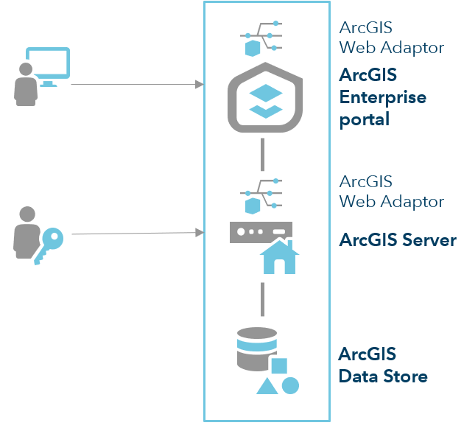
Software Components of ArcGIS Enterprise
ArcGIS Server:
Powers mapping, analysis, and geospatial processing
Dynamically scales to handle high traffic and large workloads
ArcGIS Enterprise Portal:
Central hub for users to create, share, and manage maps, apps, and spatial data
Facilitates collaboration by allowing users to share resources with others
Notes:
ArcGIS Enterprise consists of four key software components that work seamlessly together to provide a comprehensive geospatial platform for web mapping, image exploitation, real-time data processing, and large-scale spatial data science.
First, ArcGIS Server is the powerhouse behind mapping and analysis in your GIS. It supports various specialized server roles, such as real-time data handling, image processing, and large-batch analysis. What makes it particularly effective is its ability to scale dynamically, handling both light and heavy traffic effortlessly.
Next, the ArcGIS Enterprise Portal serves as the central hub where users can create, share, and manage their maps, apps, and spatial data. It’s designed to encourage collaboration, making it easy to share resources with colleagues and teams.

Slide 7
Software Components of ArcGIS Enterprise
ArcGIS Data Store:
Provides secure data storage for hosted services in the deployment
Supports high-volume data handling for hosted feature layers, imagery layers, and more
ArcGIS Web Adaptor:
Integrates ArcGIS Server and Portal with existing web servers
Notes:
To handle the large amounts of data generated, the ArcGIS Data Store provides secure storage for your hosted services, supporting high-volume feature layers, imagery, and other spatial data formats.
Finally, the ArcGIS Web Adaptor integrates ArcGIS Server and Portal with your existing web servers and security infrastructure, ensuring that access and operations are both secure and efficient within your organization.
Together, these components provide a robust, scalable, and secure platform for all your geospatial needs.

Slide 8
The Relationship with ArcGIS Online: Similarities
Centralized Platform: Both provide a central website for creating, managing, and sharing 2D and 3D data, maps, and apps.
Collaboration: Both allow sharing with select groups, the entire organization, or the public.
APIs and SDKs: Both platforms offer the same APIs and SDKs for developers, ensuring a consistent development experience.
Mapping and Analysis: Both support organization-wide mapping, data management, analysis, and collaboration features.
Notes:
ArcGIS Enterprise and ArcGIS Online are similar in several key ways. Both platforms operate around a central website where organization members can create, customize, and share 2D and 3D maps, apps, and spatial data. They both support sharing within select groups, across the organization, or even with the public. For developers, both platforms provide access to the same APIs and SDKs, ensuring consistency when building custom applications.

Slide 9
The Relationship with ArcGIS Online: Differences
Feature | ArcGIS Enterprise | ArcGIS Online
Control | Full control over updates, patches, and system management | Fully managed by Esri, including updates and maintenance
Customization | Allows for highly customized configurations to meet specific organizational needs | Limited customization since Esri controls the infrastructure
Infrastructure | Requires your organization to manage servers and infrastructure | No infrastructure management needed—Esri handles everything
Scalability | You manage scalability by provisioning additional infrastructure | Automatically scales with usage without requiring user intervention
Subscription | Requires software licenses and infrastructure costs | Only requires an organizational subscription
Notes:
However, the main differences lie in how they are deployed and managed. ArcGIS Online is a software-as-a-service (SaaS) offering, fully hosted and managed by Esri. It’s designed to be highly scalable, automatically adjusting to your usage without the need to provision extra servers or infrastructure. Esri handles all the updates and maintenance, so you’re always working with the latest version. All that’s required is an organizational subscription, making it easy to manage.
On the other hand, ArcGIS Enterprise is deployed on your own infrastructure, whether it’s on-premises, in the cloud, or on virtual machines. This means you have full control over your system—you decide when to apply patches, when to upgrade, and how to configure the system to meet your organization’s unique needs. While this offers greater customization, it also requires you to manage the infrastructure yourself.
In short, ArcGIS Online offers a more hands-off, scalable solution that Esri manages entirely, while ArcGIS Enterprise gives you complete control but requires more involvement in managing infrastructure and updates."

Slide 10
Exercise I - Login
Login to the ArcGIS Enterprise Portal
https://ags.cga.Harvard.edu/portal/home
Sign in with your email
Log in ArcGIS Pro with ArcGIS Enterprise
Find the exercise document in the GitHub repo
https://github.com/CathyW16/ArcGIS-Enterprise-Workshop/blob/main/Exercise%20documents/Exercise%201.docx

Slide 11
Chapter 2
Geospatial Big Data Fundamentals

Slide 12
Spatial Data
Spatial data represents any entity or phenomenon that can be located and visualized on a map.
Two fundamental types of geographic data:
Vector data: Represents geographic features as points, lines, and polygons (e.g., cities, rivers, and boundaries)
Raster data: Composed of a grid of cells (e.g., satellite images, elevation models)
Notes:
Spatial data refers to any kind of entity or phenomenon that can be located and represented on a map. Whether it’s the location of cities, the shape of a river, or changes in elevation, spatial data allows us to visualize these elements geographically.
There are two fundamental types of geographic data. The first is vector data, which represents features as points, lines, and polygons. For example, a city might be represented as a point, a road as a line, and a country as a polygon.
The second type is raster data, which is made up of a grid of cells. Raster data is often used for more continuous data, such as satellite images or elevation models, where each cell represents a specific value, like temperature or elevation at a specific location.
Together, these two types of data form the foundation for geographic analysis and mapping.

Slide 13
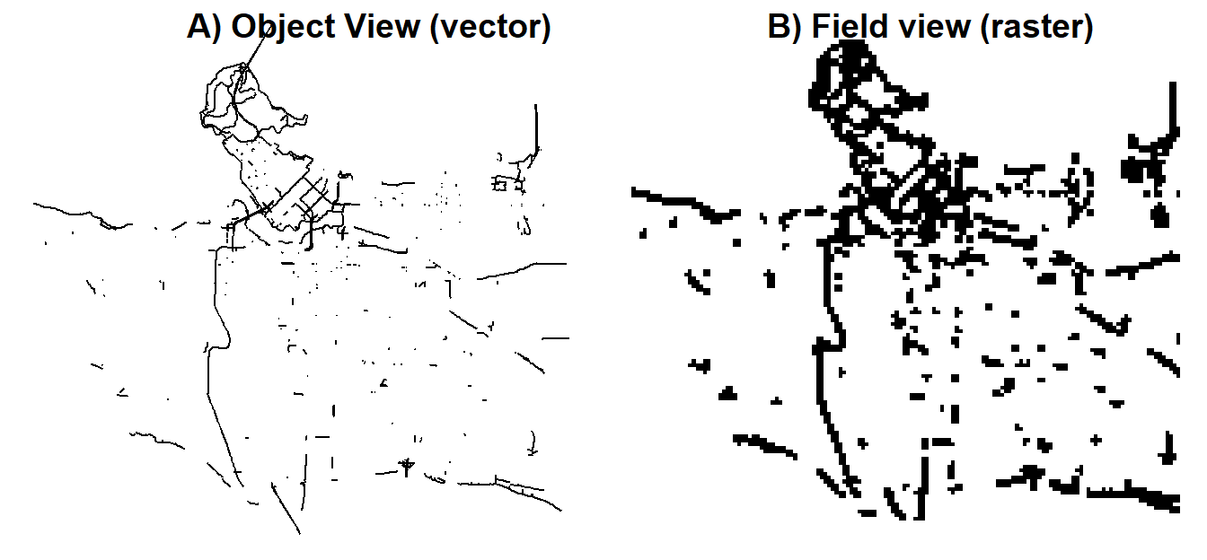
Spatial Data
Notes:
Vector data represent an object view of the world, where spatial data are discrete objects that are located in other wise empty geographic space. Vector data include points, lines and polygons. Each spatial entity can be encoded with an unlimited number of attributes that describe each point, line or polygon.
Raster data represent a field view of the world, where spatial data are represented as spatially continuous. Each location (i.e grid cell) is encoded with a single numeric value which can represent categorical outcomes (e.g. presence or absence of a bike lane) or, more typically, continuous outcomes like elevation

Slide 14
What is Big Geospatial Data?
A subset of big data that includes a spatial or geographic component
A significant portion of big data is geospatial, and its volume is growing rapidly
Managing and processing geospatial big data is crucial for decision-making in many fields
It has become an important scientific and societal challenge due to its size, complexity, and potential impact
Notes:
Big data incorporating a spatial component: “GEOSPATIAL BIG DATA” become topic for research and development community: academia, industry, government and international organizations including UN

Slide 15



Challenges in Big Geospatial Data Analytics
Volume, Velocity and Veracity of Data Storage, Transfer, Update, Streaming, Integration, Standardization, Accessibility, Security
Analysis and Visualization Complexity Coding Requirement, Resource Management, Visualization Customization
Efficiency and Scalability of Systems System deployment on cloud, Optimizing algorithms, Time-cost balancing
Notes:
When dealing with Big Geospatial Data Analytics, we encounter several key challenges that stem from the sheer scale and complexity of the data. These challenges can be grouped into three main categories: data management, analysis and visualization, and system efficiency and scalability.
First, let’s talk about the volume, velocity, and veracity of the data. Geospatial big data is massive in size, arriving in real-time from sources like satellites and sensors, which means it must be stored, transferred, and updated continuously. This creates a challenge in managing data streams, integrating data from various sources, standardizing it for consistency, and ensuring its security and accessibility across platforms.
Next is the complexity of analysis and visualization. Geospatial data is rich, but it requires sophisticated tools and techniques to make sense of it. Coding expertise is often required to handle custom workflows, and managing resources effectively becomes essential to optimize both performance and results. Additionally, geospatial visualizations often need to be highly customized to deliver insights, adding another layer of complexity.
Finally, there’s the challenge of efficiency and scalability. As data and analysis needs grow, so must the systems we use. Deploying these systems on the cloud allows for greater scalability, but we also need to focus on optimizing algorithms and balancing time and cost. Achieving efficient geospatial data analytics requires us to fine-tune both our technical infrastructure and the methods we use to process and interpret the data.
In summary, tackling these challenges head-on is critical for unlocking the potential of geospatial big data in a way that’s efficient, secure, and scalable.

Slide 16





Approaches
Move geospatial process from desktops to clouds / clusters
Manage data storage in proximity with tools for efficient access
Leverage GPU-based solutions for high performance tasks
Scale applications based on the computing needs
Containerize applications for rapid deployment and shut down
Notes:
To address the challenges of Geospatial Big Data Analytics, there are several strategic approaches that can significantly improve the efficiency and scalability of our processes.
First, we need to move geospatial processing from desktops to cloud environments or clusters. Traditional desktop processing is simply not sufficient to handle the volume and velocity of today’s geospatial data. By leveraging cloud platforms, we can access more powerful computational resources, scale dynamically, and handle larger datasets more efficiently.
Next, it's crucial to manage data storage in proximity to processing tools. Storing data closer to where the analysis happens minimizes the latency in accessing and processing the data, ensuring faster and more efficient workflows.
For high-performance tasks, we can leverage GPU-based solutions. GPUs are ideal for handling the parallel processing required for complex geospatial operations like rendering large maps or running machine learning algorithms on spatial data. This can significantly reduce processing times for tasks that would take much longer on traditional CPUs.
Scaling applications based on computing needs is another critical approach. Cloud platforms allow us to automatically scale resources up or down depending on the workload, ensuring we only use the computing power necessary at any given time, optimizing both performance and cost.
Finally, to ensure flexibility and efficiency in deploying geospatial applications, we should containerize applications. This allows for rapid deployment, scaling, and shutdown, making it easy to deploy new environments or services in a matter of seconds. Containers also ensure consistency across different computing environments, reducing compatibility issues and increasing operational efficiency.
By adopting these approaches, we can tackle the challenges of geospatial big data and make our systems more adaptable, efficient, and scalable.

Slide 17
ArcGIS Enterprise on NERC
Deployed complex data science systems on NERC with free or educational licenses:
ArcGIS Enterprise Server on NERC (educational license) provides a robust geospatial platform, serving as a private and secure system exclusively for Harvard researchers.
Hosted on a Windows Server within NERC infrastructure
Server specifications: 16 CPU cores, 64GB RAM, 700GB storage.
Notes:
We have deployed ArcGIS Enterprise on the New England Research Cloud using an educational license. This deployment is hosted on a Windows Server within the NERC infrastructure, providing Harvard researchers with a powerful and secure platform for geospatial analysis.
The Windows Server is configured with 16 CPU cores to support high-performance processing, 64GB of RAM to handle large datasets and memory-intensive tasks, and 350GB of storage to manage extensive geospatial data and analytics outputs.
This setup enables researchers to perform advanced geospatial analysis in a dedicated, private environment that is both scalable and secure. By leveraging NERC’s flexible infrastructure, this deployment ensures that researchers have the computational power they need for cutting-edge data science projects without infrastructure constraints.

Slide 18
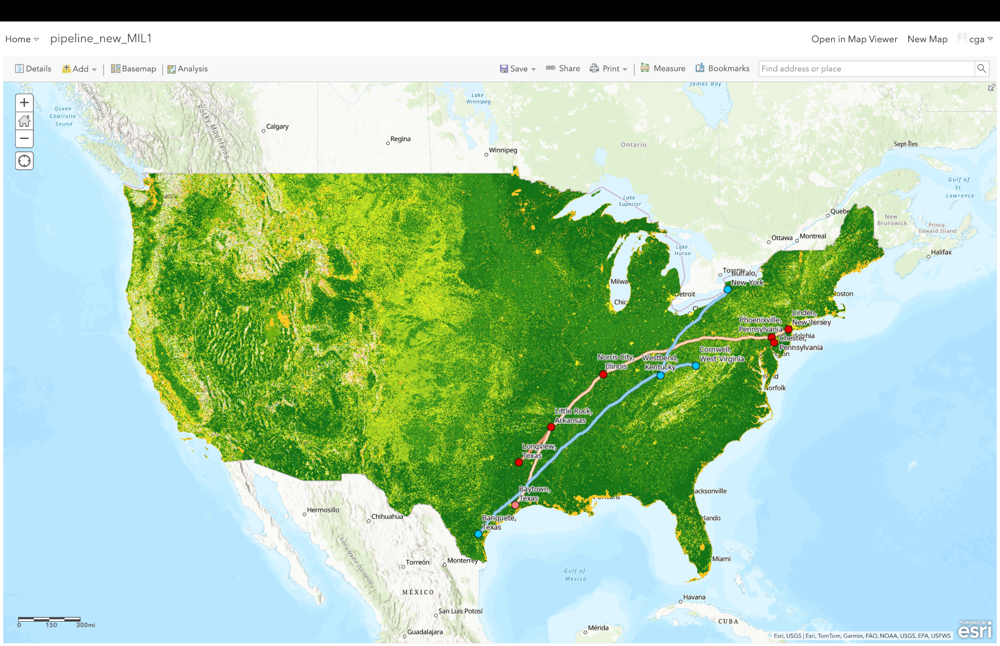






OptiPath: A Cloud-Based system for Optimal Route Calculation using ArcGIS Enterprise
RINX V2.0: A Climate Information Extraction System
Case Study: Optimal Path Calculation
Optimal Path Analysis, a complex GIS application
Pipeline Project, Harvard
Kennedy School
ArcGIS Enterprise on
cloud computing
8 paths on 250m rasters, 20GB, continental U.S.
Accurate and time efficient analysis
~10 minutes/path, 2 hours total
Notes:
I'd like to introduce Optipath, a system we developed for the Harvard Kennedy School (HKS), which is designed to perform optimal route calculations using ArcGIS Enterprise deployed on the cloud.
Optipath stands out for its ability to provide accurate and time-efficient analysis for big data routing challenges. One of the key features of the system is its capacity to handle large datasets—it's capable of calculating optimal routes on 20 GB of raster data in under 2 hours. This level of efficiency is crucial when dealing with complex geospatial problems where both accuracy and speed are essential for decision-making.
By leveraging ArcGIS Enterprise on the cloud, Optipath not only provides powerful geospatial processing capabilities but also ensures scalability and flexibility. This allows it to manage the high computational demands of large-scale routing tasks, delivering optimal results in a fraction of the time compared to traditional desktop systems.

Slide 19
Chapter 3
Data Analysis and Visualization

Slide 20
Upload data to ArcGIS Enterprise
Three ways:
Publish from ArcGIS Pro (will show in exercise)
Publish from the ArcGIS Enterprise Portal
Use ArcGIS API for Python
Notes:
First, you can publish directly from ArcGIS Pro. This is a seamless process where, after preparing your data, you can publish it straight to your ArcGIS Enterprise environment. In fact, we’ll be walking through this method in an exercise shortly.
Second, you can publish from the ArcGIS Enterprise Portal itself. The Portal provides a web interface where you can upload data files, create services, and manage your content directly within the Enterprise ecosystem. This method is great for users who want to manage their data in a centralized, web-based environment.
Lastly, for more automated or programmatic approaches, you can use the ArcGIS API for Python. This API allows for powerful scripting, enabling you to upload, manage, and publish data programmatically, which is particularly useful when working with large datasets or needing to automate repetitive tasks.

Slide 21
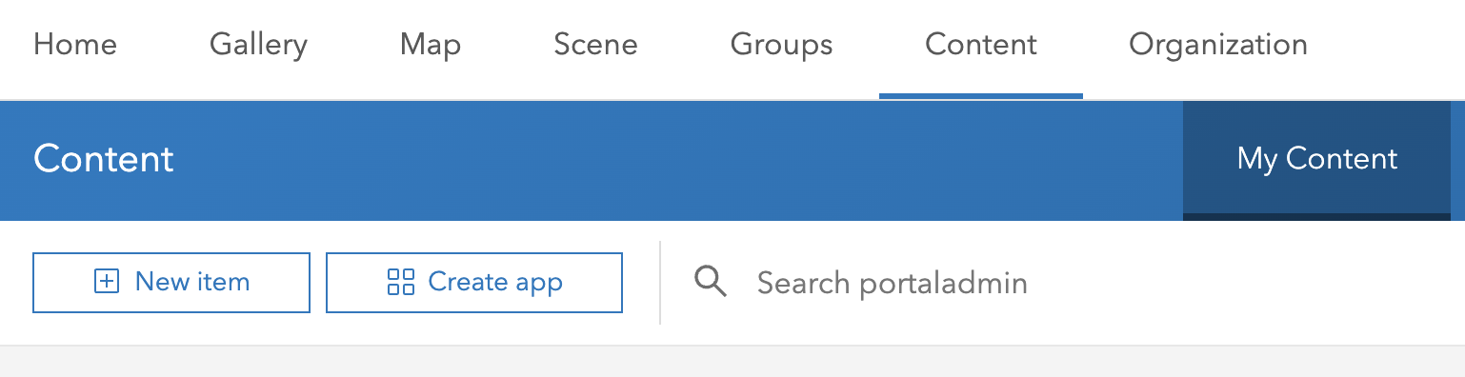
Publishing from the ArcGIS Enterprise Portal
You can upload and publish data directly through the portal interface:
Go to Content > My Content > Add Item > From my computer
Upload supported file types like CSV, shapefiles, or file geodatabases
Publish as a hosted feature layer

Slide 22
Upload data to Enterprise Using Python
Use ArcGIS API for Python
# Installation with conda
conda install -c esri arcgis
# Installation with pip
pip install arcgis
from arcgis.gis import GIS
# Connect to ArcGIS Enterprise
gis = GIS(“https://example-portal-url.com/portal”, “your_username”, “your_password”）
csv_item = gis.content.add(trailhead_properties, csv_file)

Slide 23
Spatial analysis using ArcGIS Enterprise
Three ways:
Using ArcGIS Pro (will show in exercise)
Using Map Viewer Classic on ArcGIS Enterprise
Use ArcGIS API for Python
Notes:
First, you can publish directly from ArcGIS Pro. This is a seamless process where, after preparing your data, you can publish it straight to your ArcGIS Enterprise environment. In fact, we’ll be walking through this method in an exercise shortly.
Second, you can publish from the ArcGIS Enterprise Portal itself. The Portal provides a web interface where you can upload data files, create services, and manage your content directly within the Enterprise ecosystem. This method is great for users who want to manage their data in a centralized, web-based environment.
Lastly, for more automated or programmatic approaches, you can use the ArcGIS API for Python. This API allows for powerful scripting, enabling you to upload, manage, and publish data programmatically, which is particularly useful when working with large datasets or needing to automate repetitive tasks.

Slide 24
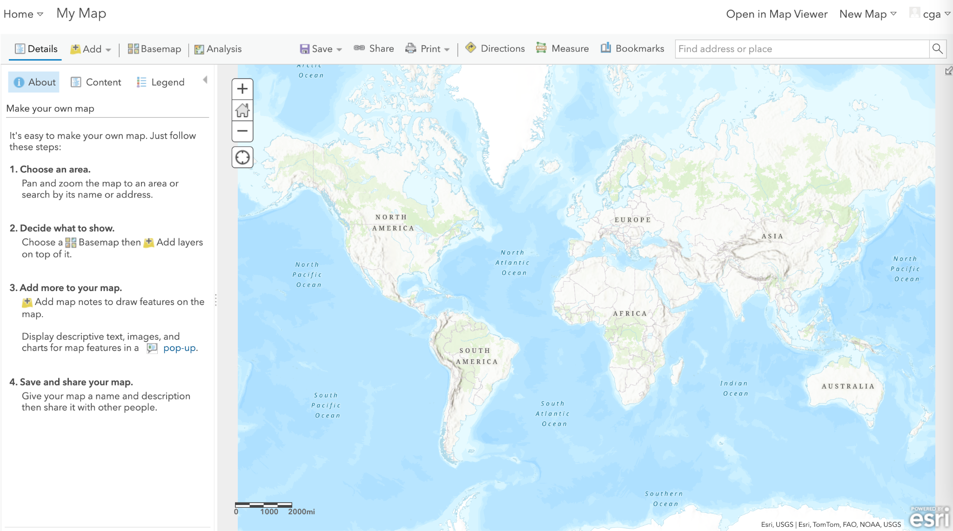
Use Map Viewer Classic
Using Map Viewer Classic
Open a web map containing the feature layers you want to analyze
Click the Analysis button on the map menu bar
Choose between Feature Analysis or Raster Analysis (if enabled)
Select a tool from the available categories
Configure the tool parameters and run the analysis

Slide 25
Spatial analysis using Python
Using ArcGIS Python API
The ArcGIS API for Python provides a comprehensive suite of tools that can be utilized for implementing geographic analysis (spatial analysis). These tools enable you to automate processes and analyze large amounts of spatial data.

Slide 26
Visualization on ArcGIS Enterprise
Three ways:
Using ArcGIS Pro (will show in exercise)
Using Map Viewer Classic on ArcGIS Enterprise
Use ArcGIS API for Python
Notes:
First, you can publish directly from ArcGIS Pro. This is a seamless process where, after preparing your data, you can publish it straight to your ArcGIS Enterprise environment. In fact, we’ll be walking through this method in an exercise shortly.
Second, you can publish from the ArcGIS Enterprise Portal itself. The Portal provides a web interface where you can upload data files, create services, and manage your content directly within the Enterprise ecosystem. This method is great for users who want to manage their data in a centralized, web-based environment.
Lastly, for more automated or programmatic approaches, you can use the ArcGIS API for Python. This API allows for powerful scripting, enabling you to upload, manage, and publish data programmatically, which is particularly useful when working with large datasets or needing to automate repetitive tasks.

Slide 27
Exercise II – Trying ArcGIS Enterprise
Upload, analysis and visualize data on ArcGIS Enterprise
Use Facilities Shapefile (https://github.com/CathyW16/ArcGIS-Enterprise-Workshop/tree/main/data/Facilities )
Find the exercise document in the GitHub repo
https://github.com/CathyW16/ArcGIS-Enterprise-Workshop/blob/main/Exercise%20documents/Exercise%202.docx

Slide 28
Chapter 4
Case study

Slide 29
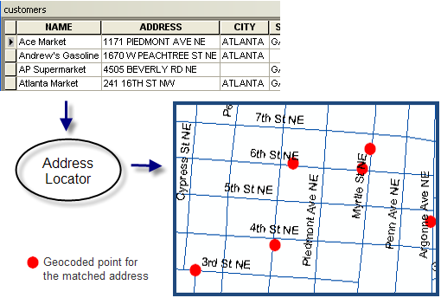
Case 1: Geocoding
Geocode: The geographic coordinates that represent a specific location
Geocoding: Process of converting a description of a location (address, place name) into geographic coordinates (e.g., latitude/longitude)

Slide 30
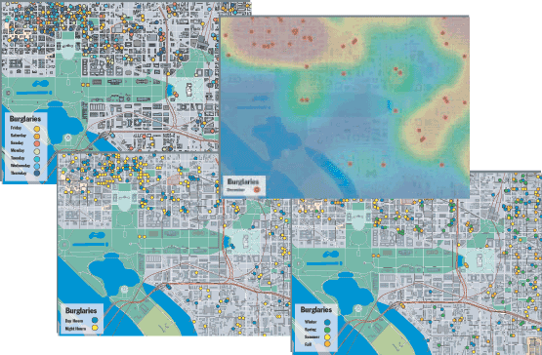
Case 1: Geocoding
Applications of geocoding:
Recognizing geographical patterns
Analyzing customer data
Verifying customer addresses
Planning retail locations
Mapping optimal routes
Tracking the movement of people and goods
…

Slide 31
Exercise III – Geocoding
Geocoding the data using ArcGIS Enterprise tool
Geocoding Incidents_addresses.csv (https://github.com/CathyW16/ArcGIS-Enterprise-Workshop/blob/main/data/Incidents_address.csv )
Find the exercise document in the GitHub repo
https://github.com/CathyW16/ArcGIS-Enterprise-Workshop/blob/main/Exercise%20documents/Exercise%203.docx

Slide 32
Case 2 : Routing with StreetMap Premium
ArcGIS StreetMap Premium is a product that provides enriched street data for use with ArcGIS software.
Key features:
High-quality, multi-scale cartographic map display
Accurate geocoding (batch, reverse, and interactive search)
Optimized routing, driving directions, and network analysis
Coverage: Available for North America, Europe, Latin America, the Middle East and Africa, Asia Pacific, and Japan.

Slide 33
Case 2 : Routing with StreetMap Premium
StreetMap Premium includes a pre-configured network dataset called Routing_ND that can be used for routing
You can perform routing analyses like:
Finding shortest/quickest routes (will show in Exercise)
Generating driving directions
Service area analysis
Closest facility analysis

Slide 34
Case 2 : Routing with StreetMap Premium
Key benefits of using StreetMap Premium for routing:
Includes up-to-date street data with traffic information
Considers factors like one-way streets, turn restrictions, etc.
Allows for time-based routing with historical traffic data
Supports various impedance options (time, distance, custom)
Can incorporate live traffic data for real-time routing

Slide 35
Exercise IV – Shortest drive time
Find shortest drive time from incidents to facilities using StreetMap Premium
Using Facilities and Incidents (https://github.com/CathyW16/ArcGIS-Enterprise-Workshop/tree/main/data )
Find the exercise document in the GitHub repo
https://github.com/CathyW16/ArcGIS-Enterprise-Workshop/blob/main/Exercise%20documents/Exercise%204.docx

